Slide 1
EE 74099 / EN 74099 Research Project
Project Title: Vision Based Navigation System for Indoor Robots
Progress Presentation
17.06.2019
Under the Supervision of : Dr. WGCW Kumara
And Eng. Abdul Cadar
Team Members:
ANFM. Begum - SEU/IS/13/EG/002
GSU. Ahmadh - SEU/IS/13/EG/011
IIS. Prema Sri - SEU/IS/13/EG/032

Slide 2
Drawing 2D Map of the canteen and navigating the robot
This week we worked on,
Drawing a 2D map of the canteen
And then converting it to Graph
Finding path to the target destination
Navigating the robot to the destination

Slide 3
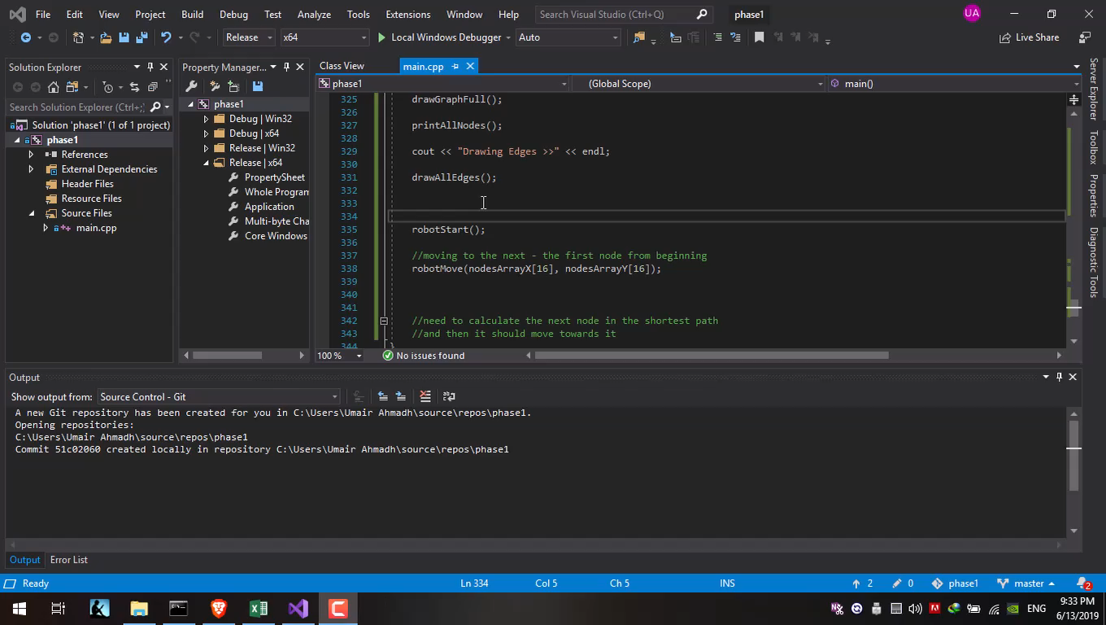

Slide 4
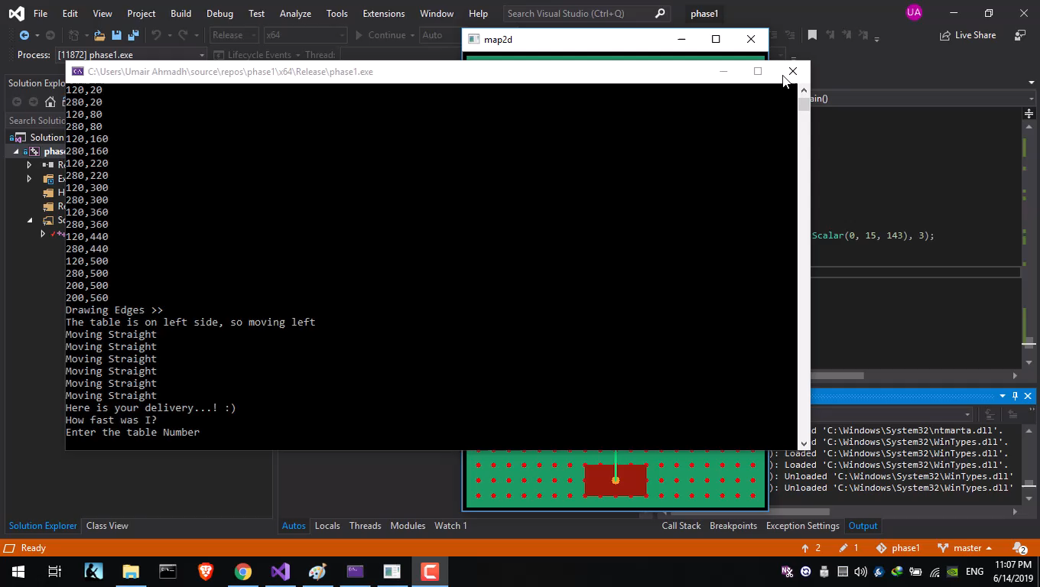

Slide 6
Next,
No dynamically moving obstacle was considered in this.
We will work on dynamic path planning based on the clearance of previously planned path for the robot.

Slide 7
Thank You

